Slide 1
Sustainable resource management
Fyodor Malchik

Slide 2
Target 9, Goal 7 of the Millennium Development Goals
“Ensure Environmental Sustainability”
“Integrate the principles of sustainable development into
country policies and programs and reverse the loss
of environmental resources.”
The indicators linked to this target refer to:
Forest cover and biodiversity
Sustainable energy
Water

Slide 3
WSSD Plan of Implementation
Managing natural resources in an integrated
Manner is essential for sustainable development
In Johannesburg, international consensus was reached around
the two basic approaches that should organize the global effort
towards environmentally sustainable development:
Integrated management of natural resources, including energy;
Enhancement of cooperation and synergies, with emphasis
on the regional level.

Slide 4
A compelling rationale for the need of a GEF response
to the call for integration:
The clear and coherent message deriving from MDGs and WSSD
The GEF Operational Strategy that recognizes the need for
integrating water, land use and biodiversity, and adopts the
ecosystem approach
The size of the GEF portfolio - risks of overlaps and antagonistic
linkages in many geographic areas
The addition of the Land Degradation focal area
The new focus on climate change adaptation
The recommendations of STAP on interlinkages and groundwater

Slide 5
An enabling environment for stress reduction
On the ground integration can be experimented more effectively when the stage of the implementation of stress reduction/mitigation measures has been reached, and the enabling environment is in place.
These four pre-requisites may provide the criteria for identifying and selecting the opportunities for integration where action can be taken in the short term.

Slide 6
Breaking focal area barriers:
Possible actions
Merging of resources
Increase in PDF-B funds for the design of integrated projects and multi-project programs
Incentives (fee premiums?) to encourage our agencies to engage in integrated programs
Adoption of a new set of overall “GEF strategic priorities”, which would privilege integration
Creation of new multi-focal operational programs (Integrated Natural Resources Management in Hydrographic Basins, or “Energy for Environmentally Sustainable Development in LDCs and SIDS)
systematic dialogue among focal areas in the Secretariat and Task Forces and strengthening of Task Forces

Slide 7
The new challenge in the IW focal area:
Catalyzing an Integrated Response to
Strategic Action Programs
LAND
WATER
BIODIVERSITY
CLIMATE
CONTAMINANTS

Slide 8
EXAMPLE OF A
POSSIBLE INTEGRATED
APPROACH
THE CASPIAN SEA BASIN
The Challenge:
Sustainable Integrated
Management of the
Caspian Environment

Slide 9
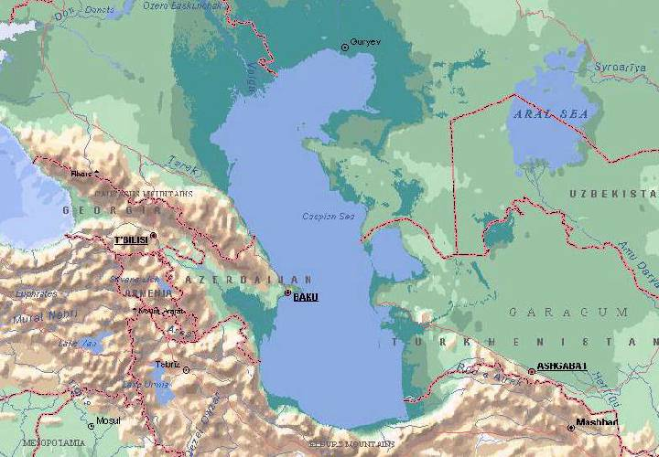
Kazakhstan
Russian Federation
Azerbaijan
Turkmenistan
Iran

Slide 10
As a result of a first IW - GEF project,
the riparian countries have agreed on a
Strategic Action Programme and on a
binding environmental Caspian Convention

Slide 11
Transboundary Diagnostic Analysis
A science based TDA
has guided in defining targets,
strategies, priorities
Strategic Action Programme
The SAP for the Caspian Basin
has been adopted by the littoral
countries. It is a commitment to action.
National Caspian Action Plans
Actions identified in the SAP
are being translated into national
commitments

Slide 12
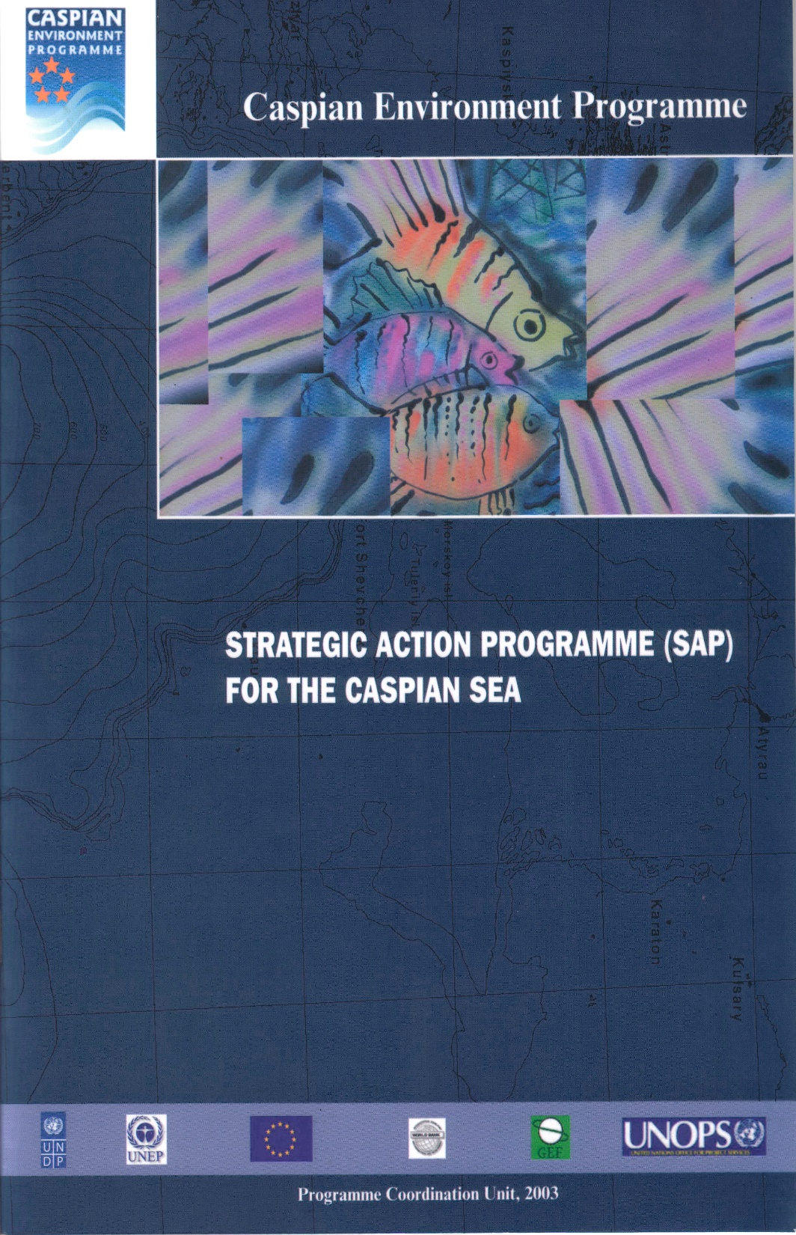
Priority regional environmental
concerns identified by the TDA and
addressed by the SAP:
Over-exploitation
of bio-resources
Threats to biodiversity
Water pollution
Unsustainable coastal
area development

Slide 13
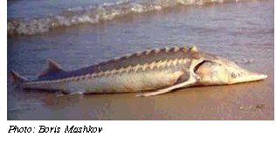
Objective 1
Conservation and Sustainable
Use of Bioresources
Promote regional agreement
Introduce Quota System
Strengthen Compliance, enforcement and monitoring
Reduce Illegal Trade
Target 1: Sustainable Commercial
Fisheries
Protect and manage natural spawning grounds
Improve hatchery efficiency
Creation of a gene bank for anadromous fish stocks
Target 2: Rehabilitate Stocks
of Sturgeon, Herring
Target 3: Reduce dependency
of coastal communities
Promote small scale aquaculture
Promote alternative livelihoods (pilot projects)

Slide 14
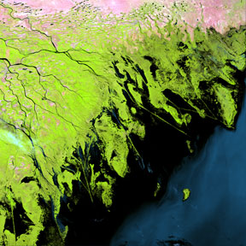
Objective 2
Conservation of Biodiversity
Target 1: Increased Regional Collaboration
Target 2: Key species maintained/restored to viable levels
Target 3: Control of alien species
Target 4: Implementation of regional system for protection
of marine and coastal habitats
Target 5: Restored priority coastal habitats
Target 6: Restored priority marine habitats (five demos)

Slide 15
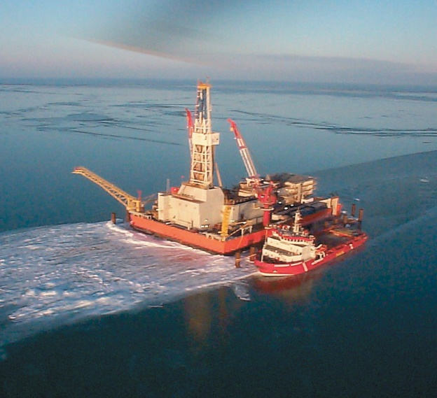
Objective 3
Improve the Water Quality
Target 1: Strengthen enforcement and management
Target 2: Implement regional water quality monitoring
Target 3: Adopt Protocols on LBA, Hazardous substances and Dumping - Implement regional strategies
for pollution reduction
Target 4: Implement POPs stockpiles disposal and land decontamination plans
Target 5: Promote env. sound agricultural practices
Target 6: Disaster prevention response (oil spills)

Slide 16
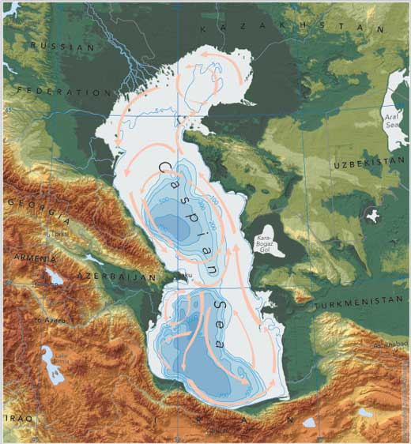
Objective 4:
Sustainable Development
Of Coastal Zones
Target 1: Introduction of ICZM (five demos)
Target 2: Combat Desertification and Deforestation Process
Reverse land degradation in priority areas (demos)
Introduce renewable energy alternatives to fuel-wood
Introduce sustainable grazing practices

Slide 17
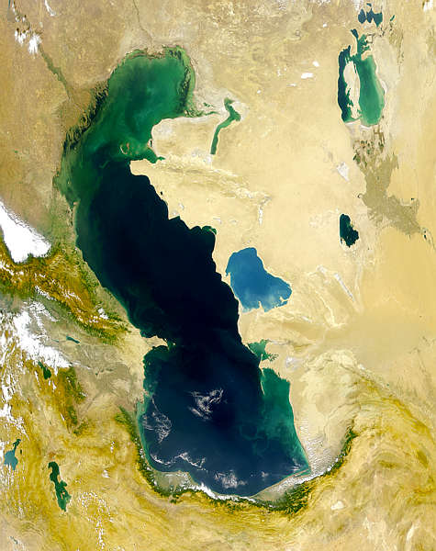
By joining forces in SAP Implementation, the GEF Focal Areas
(IW, Biodiversity, POPs, Land Degradation, Climate Change)
can assist the Caspian countries to respond to the challenge
of integrated natural resources management in the Caspian Basin
POPs: Stockpiles Disposal,
Decontamination of sites
IW: Coastal management,
Fisheries, pollution reduction
Land Degradation:
Sustainable grazing,
Soil Conservation demos
Biodiversity: Protected areas,
control of alien species,
habitat restoration
Climate Change: Rural
electrification - RETs as
alternatives to fuel-wood

Slide 18
Conservation of Wetland Biodiversity
in the Lower Volga Region
GEF Projects under
implementation or
preparation
with relevance for the
Caspian Basin
Integrated Conservation of Priority
Globally Significant Migratory
Bird Wetland Habitat - Kazakhstan
Lack of integration
Kura Aras Basin
Management
Conservation of Iranian Wetlands

Slide 19
Strategic Partnership
Investment Fund
Investment projects,
demonstrations
Regional Project
Reforms,
capacity building
Replication mechanisms
Projects

Slide 20
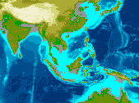
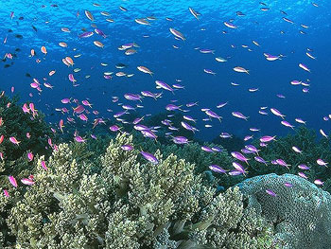
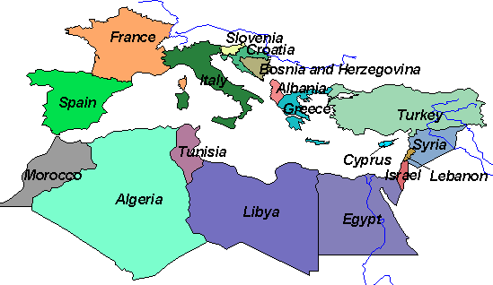
New Strategic Partnerships have entered the GEF Pipeline:
The Pollution Reduction Fund for
the East Asian LMEs
(World Bank with UNDP - IMO)
The Sustainable Fisheries Fund
for Sub-Saharan Africa LMEs
(World Bank - FAO – WWF
With UNDP and UNEP)
Others are being identified and designed:
The Strategic Partnership for the
Mediterranean Sea LME
(World Bank - UNEP)

